Slide 1
Real-Time Task Scheduling
A.NIHAL UR RAHMAN
192111024

Slide 2
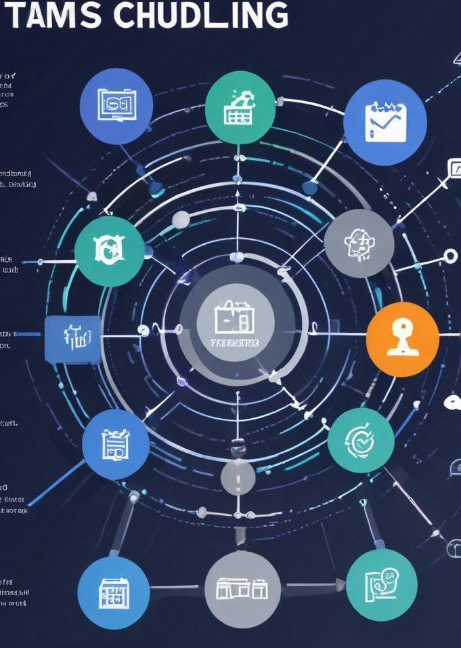
Introduction
This presentation covers essential aspects of simulating real-time task scheduling for embedded systems, focusing on its importance, various types of scheduling algorithms, and the challenges faced in practical applications.

Slide 3
01
Task Scheduling

Slide 4

Definition and Importance
Task scheduling in embedded systems is crucial for managing how tasks are allocated time on processors. Proper scheduling ensures efficiency, timely task completion, and optimal resource usage. Understanding its importance can significantly impact system reliability and performance, especially in real-time applications where timing is critical.

Slide 5
Types of Scheduling Algorithms
There are several types of scheduling algorithms commonly used in embedded systems, including:
**Rate Monotonic Scheduling (RMS)**: Prioritizes tasks based on their periodic execution rates.
- **Earliest Deadline First (EDF)**: Schedules tasks based on their deadlines, favoring those with the nearest deadlines.
- **Least Laxity First (LLF)**: Focuses on task 'laxity', scheduling tasks that can afford to wait the least time.
Each algorithm has its strengths and ideal use cases, influencing how tasks are processed and ensuring system responsiveness.

Slide 6
Challenges in Scheduling
Scheduling in embedded systems presents several challenges, including:
- **Resource Contention**: Multiple tasks may compete for limited processing resources, leading to delays.
- **Task Variability**: The unpredictable nature of task execution times can complicate scheduling strategies.
- **Dynamic Changes**: Real-time systems often face varying operational conditions, necessitating adaptive scheduling solutions to maintain performance and meet deadlines.

Slide 7
02
Simulation Techniques

Slide 8
Real-Time Simulation Environments
Real-time simulation environments allow developers to model, test, and debug embedded systems effectively. These environments simulate various aspects, such as hardware interactions and software processes, providing insights into system behavior under realistic conditions. Popular environments include co-simulation platforms that integrate hardware and software simulations, enabling a comprehensive analysis of task scheduling and performance metrics.

Slide 9
Simulation Tools and Frameworks
Several tools and frameworks facilitate the simulation of task scheduling in embedded systems, including:
- **MATLAB/Simulink**: Offers extensive libraries for modeling and simulating complex systems.
- **OMNeT++**: A versatile, modular platform for network simulations applicable in task scheduling scenarios.
- **SystemC**: Provides a set of C++ classes and macros to model hardware and software systems, crucial for simulation purposes. Using these tools can enhance understanding and optimization of scheduling algorithms in embedded applications.

Slide 10

Case Studies and Applications
Numerous case studies illustrate the practical applications of real-time task scheduling simulations. These include:
- **Automotive Systems**: Simulations improve the scheduling of tasks in braking and engine control systems, enhancing safety.
- **Robotic Applications**: Real-time scheduling ensures that robotic tasks are executed efficiently, allowing for better responsiveness in dynamic environments.
- **Telecommunications**: Effective task scheduling impacts data transmission reliability and quality, crucial for maintaining service-level agreements.

Slide 11
Conclusions
Simulating real-time task scheduling in embedded systems is critical for optimizing performance. By understanding the challenges, employing effective simulation techniques, and learning from case studies, developers can enhance system efficiency, responsiveness, and reliability, leading to improved outcomes in real-world applications.

Slide 12
THANK YOU

